Slide 1
Romain College oF Business IT Alliance spring 2021 Meeting Cathy Carey, Dean Romain College of Business University of Southern Indiana

Slide 2
Open Positions in the RCOB
Accounting and Finance Department Assistant/Associate Professor of Finance Assistant Professor of Accounting Instructor in Accounting Economics and Marketing Department Assistant Professor of Economics Assistant Professor of Marketing Instructor of Marketing Assistant Professor of Agricultural Business (new position) | Management and Information Sciences Assistant Professor of Management (2) (new positions to meet MBA and BUAD demand) Instructor of Management Assistant Professor of Computer Information Systems (2) Dean’s Office Administrative Assistant

Slide 3
Romain college of Business Vision and mission Creating Value Through Impact
To develop distinctive graduates who create value through innovative and impactful business solutions.
To deliver a premiere student-centered business education that incorporates excellence through experiential learning, scholarship, and collaboration with business and community partners.

Slide 4
Core values
Distinction
Passion for Excellence
Integrity
Diversity and Inclusion

Slide 5
Strategic Priorities
Prepare
#1
Deliver
#3
Deliver visible impacts on society at the local, regional, state, and national level.
Support
#4
Support opportunities that enhance faculty skills and capabilities.
Embrace
#2
Create a culture that embraces diversity and inclusion.
Prepare learners to make meaningful impacts in the workplace.

Slide 6
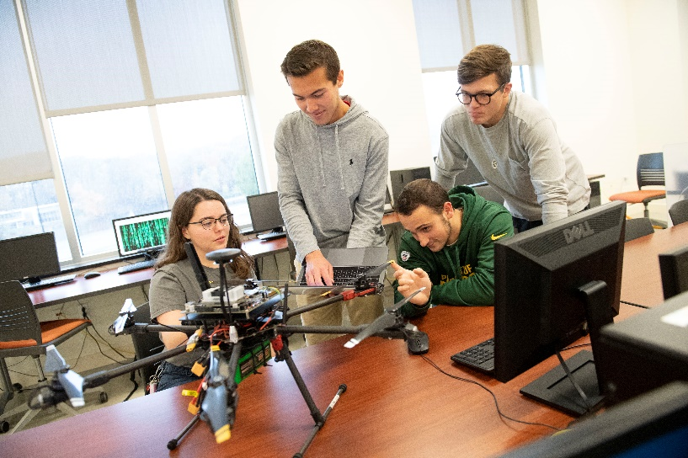
PEDS Plan
#1 Prepare
#2 Embrace
#3 Deliver
#4 Support

Slide 7
Ways to get Involved
Speakers
Senior Projects
Data for analysis
Student/Faculty Internships
Screagles Mentoring Program
Funding f
student clubs and competitions,
faculty research,
travel to conferences,
software, etc.

