Slide 1
2020 CS Summer Camps
Presented by Scott Anderson
November 10, 2020

Slide 2
2020 CS Summer Camps
2020 Online CS Summer Camp Timeline
January 17 – Started investigation of registration with Allison Grabert
January 17 – Began working with Cindy Miller on Touchnet
February 26 – Verified Account and Touchnet with Cindy Miller
March 2 – Worked with Allison Grabert on getting registration with Qualtrics up
March 4 – Kat Draughton approves registration site
March 4 – On-campus registration up and going
March 4 – Darla Perigo adds newsletter article with link to registration
March 16 – Darla Perigo adds registration to rotator in RCOB webpage
April 1 – On-campus summer camps suspended, links to registration removed
April 16 – Dean Carey asks about possible virtual camps
April 20 – Meeting with Dawn Stoneking regarding Outreach and Engagement participation
April 23 – Dean Carey gives go-ahead for online format
April 24 – Darla Perigo posts RCOB webpage announcement (reposts from on-campus format)
April 24 – Vic Chamness (EVSC) sends letter to all Science/STEM teachers in EVSC, Warrick, Posey and Gibson counties
April 26 – Vic Chamness adds camps to EVSC summer class list https://www.evscschools.com/summercamps
April 30 – Darla Perigo posts ad on RCOB Social Media
May 1 – Srishti Srivastava and Wendy Wooldridge commit to camp project
May 4 – Vic Chamness (EVSC) sends letter to all Science/STEM teachers in EVSC
May 15 - Allison Grabbert sends blast email to SWISTEM Resource Center email list and posts on Facebook Page
May 22 – IndianaComputes! content draft available for review
May 23 – MyUSI Events request submitted
June 1 – EVSC sent out last announcement
June 1 – Notified USI University Communications (not sure Calendar entry triggered them).
June 2 – Zoom training with Sara Jay
June 4 – Asked Walter Fisher to add names in BlackBoard
June 4 – Ran test with Zoom hosting
June 4 – Sent out Zoom test email to middle school students and parents
June 5 – Had Zoom test with 3 middle-schoolers
June 5 – Ordered T-Shirts
June 8 – First day for middle school camp
June 15 – First day for high school camp

Slide 3
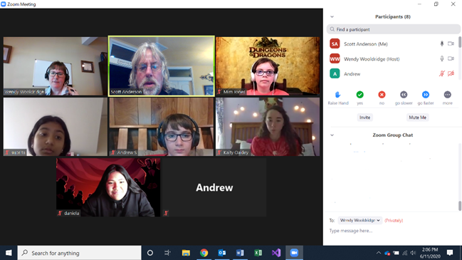
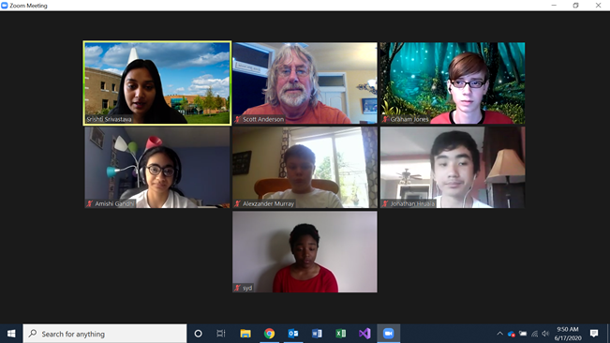
2020 CS Summer Camps

Slide 4
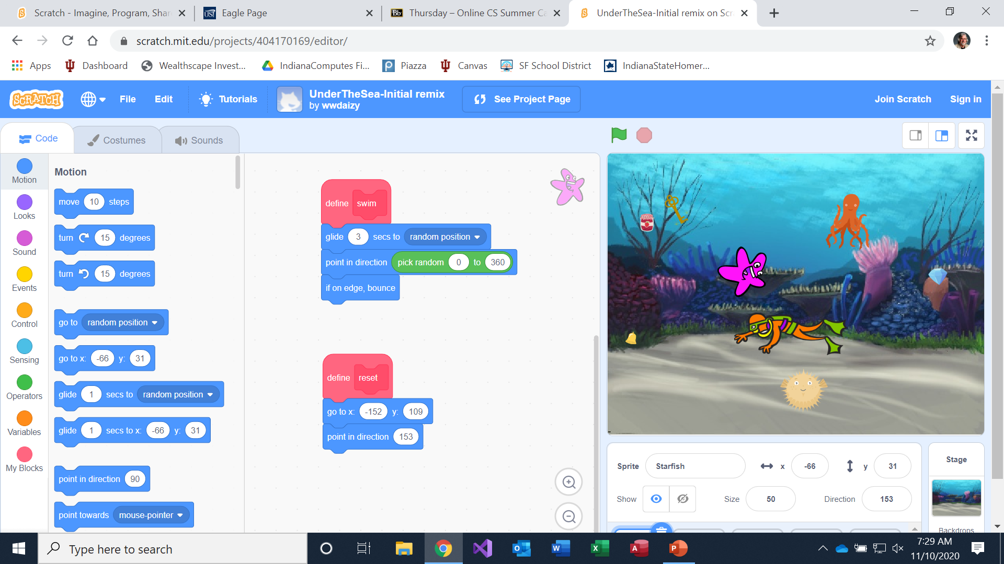
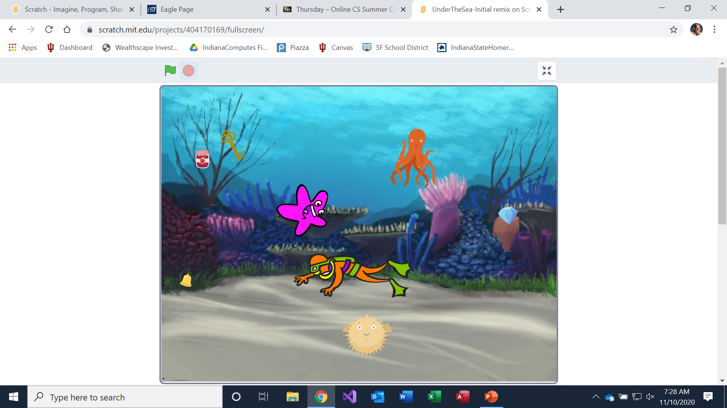
2020 CS Summer Camps

Slide 5
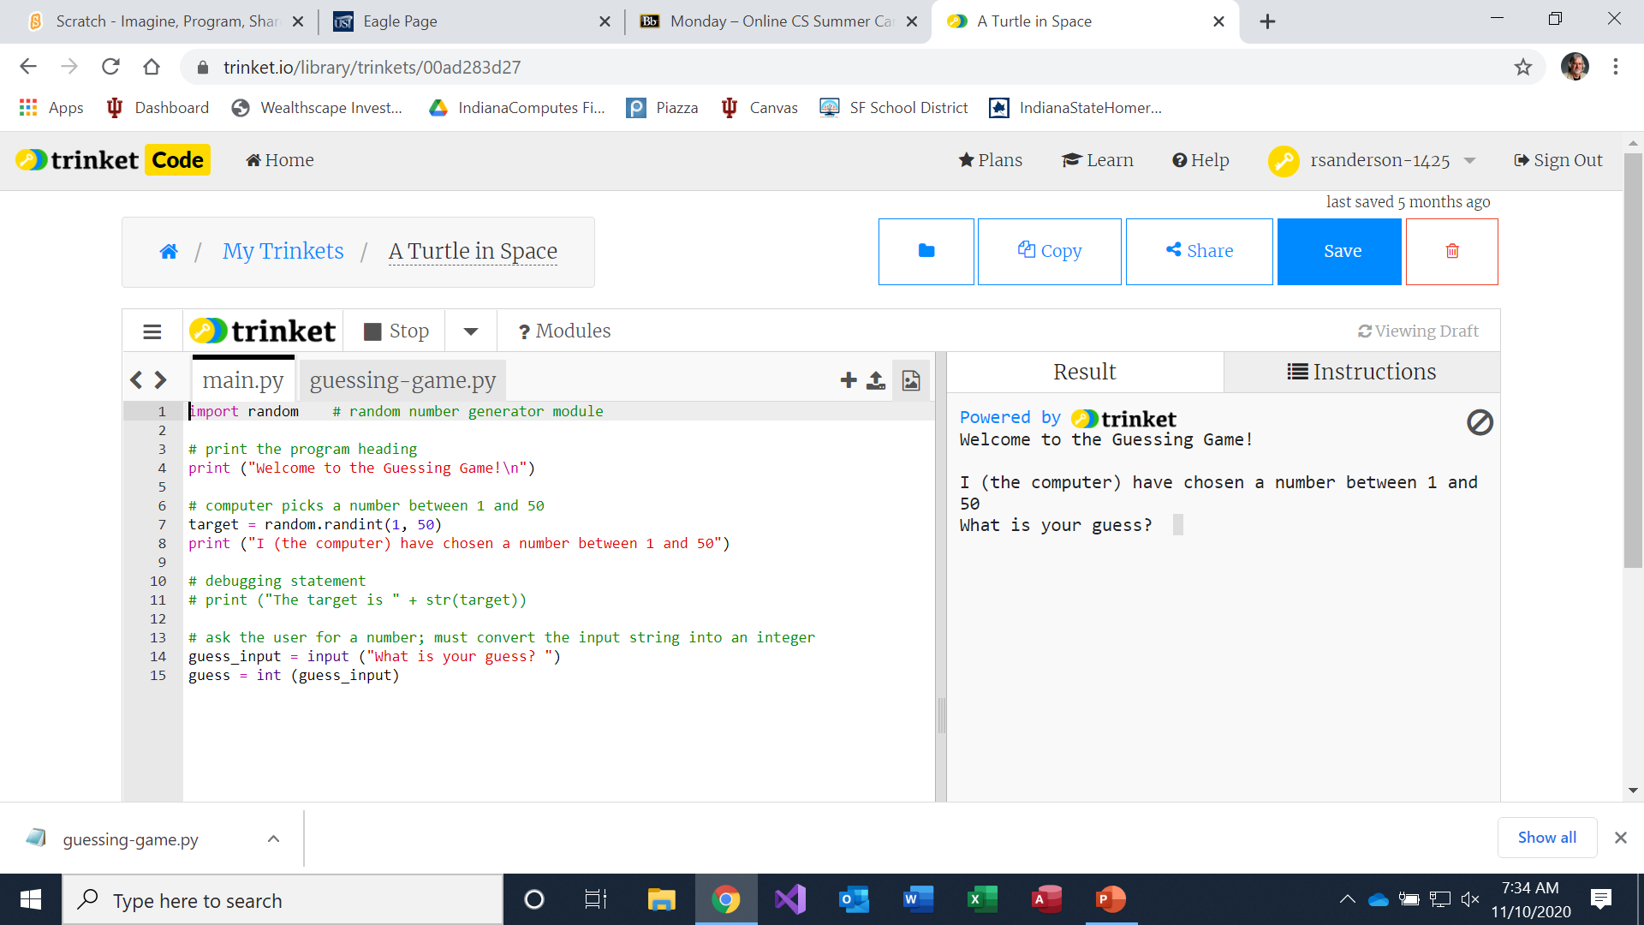
2020 CS Summer Camps

Slide 6
2020 CS Summer Camps
Middle School Evaluation
Assessment (score/n) Pre Post
My level of experience programming is:
My new level of experience programming is: 17/6 25/6
My level of interest in learning to program is:
My new level of interest in learning to program is: 25/6 25/6
I expect this camp to help me in school:
I think this camp will help me in school: 18/6 16/6
I expect this camp to help me as a person:
I think this camp will help me as a person: 22/6 18/6
I am somewhat afraid of the work I might have in this camp:
I think this camp was hard: 9/6 16/6 (inverted)
I expect to have fun in this camp:
I had fun in this camp: 25/6 28/6

Slide 7
2020 CS Summer Camps
High School Evaluation
Assessment (score/n) Pre Post
My level of experience programming is:
My new level of experience programming is: 10/5 22/5
My level of interest in learning to program is:
My new level of interest in learning to program is: 22/5 22/5
I expect this camp to help me in school:
I think this camp will help me in school: 20/5 20/5
I expect this camp to help me as a person:
I think this camp will help me as a person: 17/5 18/5
I am somewhat afraid of the work I might have in this camp:
I think this camp was hard: 8/5 9/5 (inverted)
I expect to have fun in this camp:
I had fun in this camp: 20/5 24/5

