Slide 1
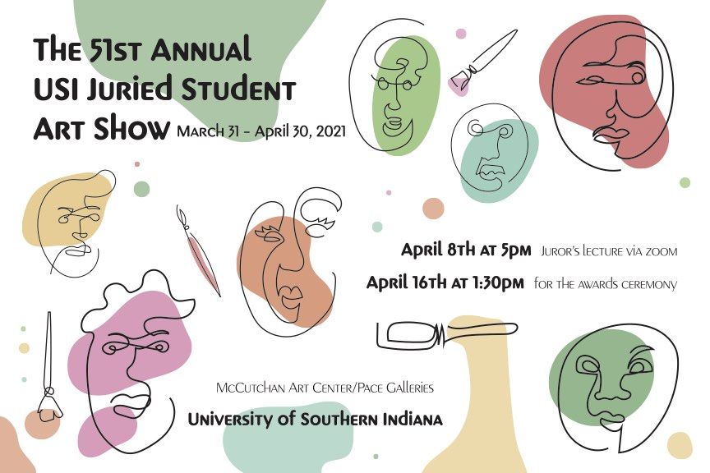

Awards Presentation

Slide 2

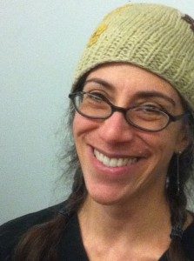
About the Juror Anne Galperin
Anne directs the Graphic Design BFA program at the State University of New York, New Paltz and is an Associate Professor in the Art Department, teaching courses in design theory and criticism, and research methods. Se earned a BSc in Human Development and Social Policy with honor for Northwestern University in Chicago, Illinois and an MFA in 2D design from Cranbrook Academy of Art in Bloomfield Hills, Michigan. A decade of educational book writing and general editing preceded her MFA. Her early career focused on print design, and she is the recipient of two merit awards from Bookbuilders West and a Print Magazine Regional Design Award.

Slide 3
University of Southern Indiana
51st Annual Juried Student Art Exhibition Awards
Thank you all of to our donors!
These awards and scholarships are specific to the Student Art Exhibition. Endowed scholarships from generous alumni and friends that provide meaningful financial assistance to art & design students every year are not listed here.

Slide 4
University of Southern Indiana
51st Annual Juried Student Art Exhibition Awards
Thank you all of to our donors!
Sol and Arlene Bronstein Art Scholarship Endowment
Robert W & Carol Clausen Carithers Art Scholarship Endowment
Elizabeth Zutt Art Student Enrichment Program Endowment
Charles E Hirsch Fine Arts Scholarship Endowment
Anne and Lenny Dowhie Art Scholarship Endowment
Ellinor Hanger Goldman Memorial Art Scholarship Endowment
Funded by Charles Goldman
Siegfried R and Carolyn W Weng Art Scholarship Endowment
James E Parrent, Jr Art Scholarship Endowment
Funded by Connie Weinzapfel ’78
Dewig deJong Design Scholarship Endowment
Funded by Joan Dewig deJong
Doolittle Art Department Endowment
Funded by Harry C. & Misook P. '85 Doolittle
Efroymson Family Fund Bridge Year Fellowship

Slide 5
University Purchase Awards

Slide 6
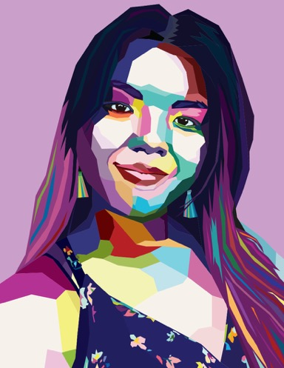
University Purchase Awards
Purchase Award Amount: $100
Kassiti Fink
Title: Colorful Me (illustration)
Gift of: Corliss Chastain, Stephen W. Pfingston '75 & Linda Westfall, Daniel J. & Susan C. M'16 Sauls

Slide 7
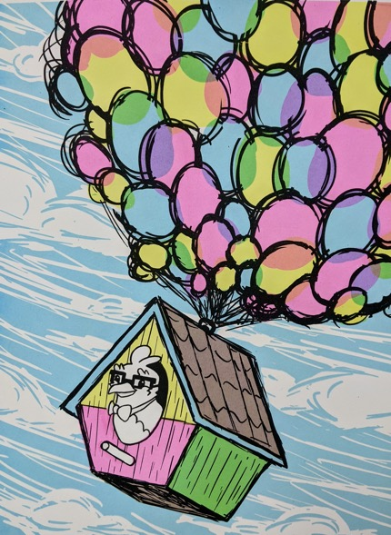
University Purchase Awards
Purchase Award Amount: $100
Emerald Greene
Title: Adventure Awaits (screenprint on paper)
Gift of: Gregory A. '78 & Ann E. Folz, Elaine Thompson

Slide 8
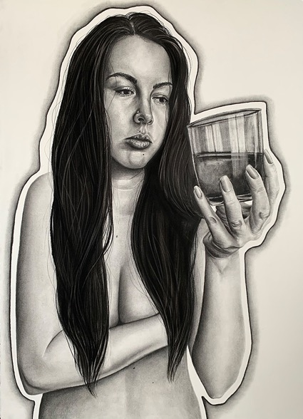
University Purchase Awards
Purchase Award Amount: $300
Kiersten Slocum
Title: Overwhelmed (charcoal on paper)
Gift of: Gregory A. '78 & Ann E. Folz

Slide 9
Art Club Member Awards

Slide 10
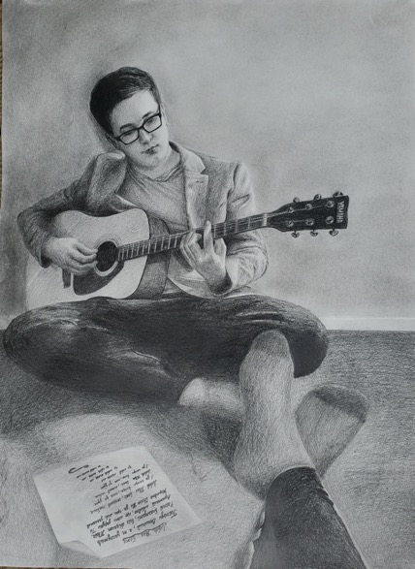
Art Club Member Awards
Art Club Member Award Amount: $250
Viktoriia Mayatska
Title: '"Качественное Bремя" (Quality Time) (graphite on paper)
Gift of: USI Art Club

Slide 11
Art Club Member Awards
Art Club Member Award Amount: $250
Carli Murkve
Title: Daughter & Doghter + Fox & The Grapes Animatic (digital illustration + digital illustration)
Gift of: USI Art Club

Slide 12
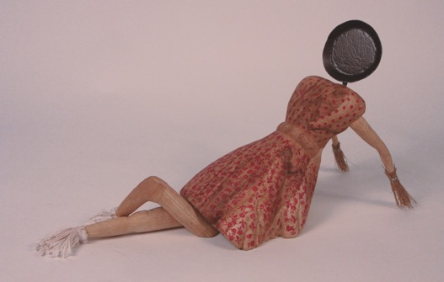
Art Club Member Awards
Art Club Member Award Amount: $250
Justine Schopmeyer
Title: Not Your Housewife + Twisting Patience (ash, steel, yarn, broom corn, wire, relief stamping + cottonwood, walnut)
Gift of: USI Art Club

Slide 13
Merit Awards: 3D Studio

Slide 14
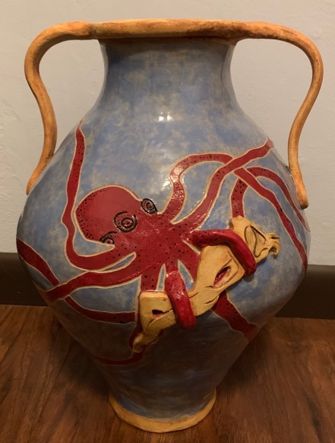
Merit Awards: 3D Studio
Ceramics Merit Award Amount: $150
Gabrielle McCarty
Title: Inescapable #metoo (clay)
Gift of: Paul W. Benshoof & Alisa I. Holen, Neal & Jef Franklin

Slide 15
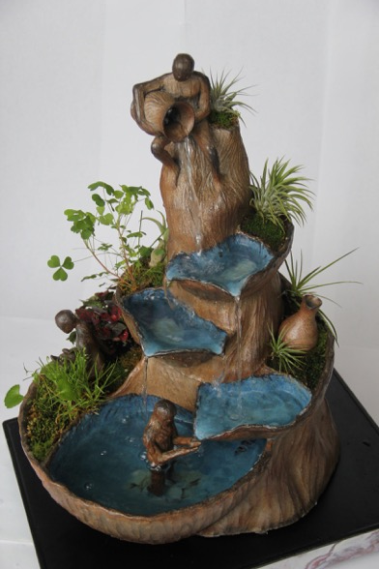
Merit Awards: 3D Studio
Sculpture Merit Award Amount: $150
Faith Long
Title: Respite (woodfire stoneware)
Gift of: Janet Mills, Joseph & Joy C. M'18 Uduehi

Slide 16
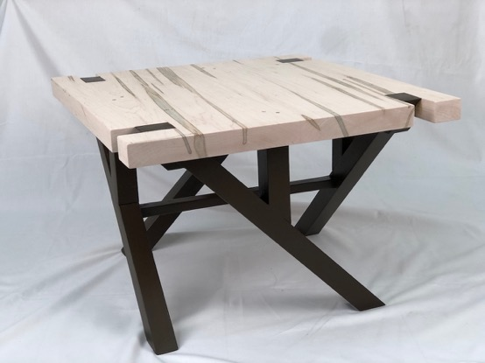
Merit Awards: 3D Studio
Woodworking Merit Award Amount: $150
Casey McDaniel
Title: Ambrosia Table (ambrosia maple, poplar)
Gift of: Ron Weatherford, Anonymous Friend

Slide 17
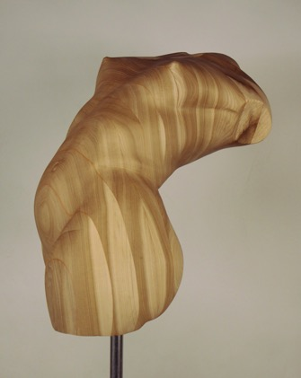
Merit Awards: 3D Studio
Dee Millard Memorial Award in Woodworking Amount: $250
Ally Hinton
Title: A Dance With Poison Ivy (poplar)
Gift of: Robert Millard-Mendez & Nancy E. Raen-Mendez, Gregory J. Blair & Sara A. Christensen Blair

Slide 18
Merit Awards: 2D Studio

Slide 19
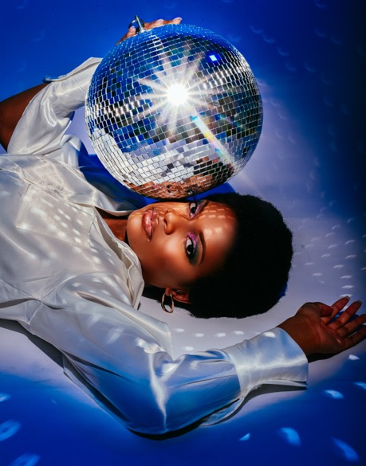
Merit Awards: 2D Studio
Photography Merit Award Amount: $150
Bree Neely
Title: Disco Fever (inkjet print)
Gift of: Jennifer L. Porter-Kieffer '06, Laurel Vaughn

Slide 20
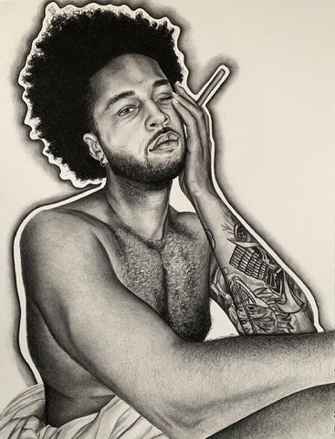
Merit Awards: 2D Studio
Drawing Merit Award Amount: $150
Kiersten Slocum
Title: Get By + Overwhelmed (charcoal on paper + charcoal on paper)
Gift of: Joseph C. & Connie D. McConaughy

Slide 21
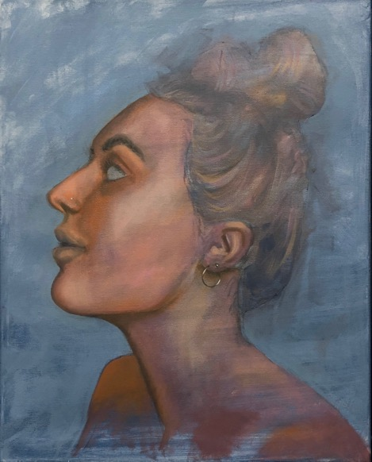
Merit Awards: 2D Studio
Painting Merit Award Amount: $150
Peyton Broshears
Title: Dear Macy, Your Nose is F*cking Normal (oil on canvas)
Gift of: Matthew R. Graham & Kathryn M. Waters

Slide 22
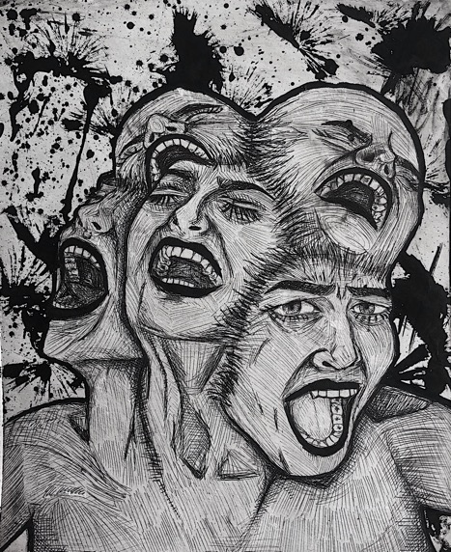
Merit Awards: 2D Studio
Printmaking Merit Award Amount: $150
Cheyenne Miller
Title: Undercurrents of Grief (drypoint and ink)
Gift of: Joseph C. & Connie D. McConaughy

Slide 23
Merit Awards: Design

Slide 24
Merit Awards: Design
Graphic Design Merit Award Amount: $150
Rakel Campbell
Title: Design Culture Now Poster (digital)
Gift of: Shaobai Gao & Xinran Hu

Slide 25
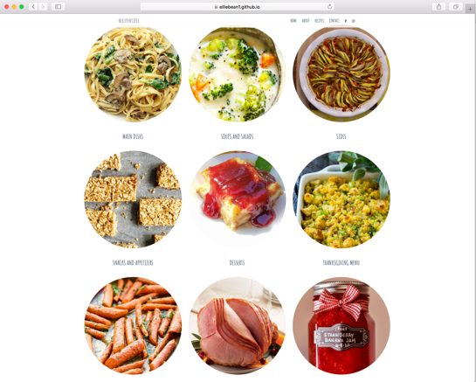
Merit Awards: Design
Interactive Media Merit Award Amount: $150
Elizabeth Neeley
Title: Neeley Recipes (digital)
Gift of: Michael R. Deicken '76, Brian W. Price '93 & Stephanie D. Purcell, The Estate of Betty F. Rice

Slide 26
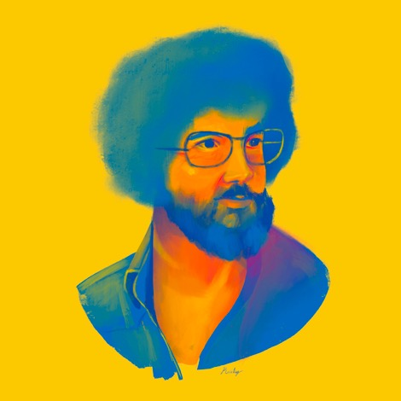
Merit Awards: Design
Illustration Merit Award Amount: $150
Railey Gray
Title: The Ross (digital)
Gift of: Charles T. Barber & Carolyn L. Roth

Slide 27

Merit Awards: Design
Publication, Poster, or Informational Graphics Design Merit Award Amount: $150
Jacob Wedding
Title: Type Specimen Book (digital)
Gift of: Izzy Ferraro ’19, Rebecca Lutton, Tom & Lynda Wilhelmus

Slide 28

Merit Awards: Design
Branding Merit Award Award: $150
Alicja Ackermann
Title: Himalaya Resort Stationery (digital)
Gift of: Alexander M. '13 & Kristina F. '13 Arwood, Thomas A. & Joanne Scott '84 Massey

Slide 29
Scholarship Awards

Slide 30

Scholarship Awards
Sophomore Scholarship Amount: $500
Hope Burdette
Title: Distinguished Characters + Ewha Station (digital + digital)
Gift of: Michael M. Finkelstein '03

Slide 31
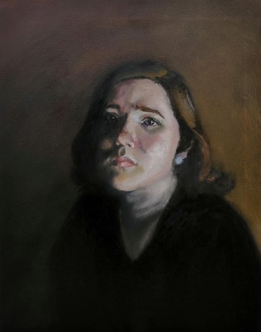
Scholarship Awards
Junior Scholarship Amount: $500
Alyssa Theriac
Title: Portrait #3 + Paint Can? + Digital Love (oil on canvas + oil on canvas + ceramic, ear buds)
Gift of: Linda Willis

Slide 32
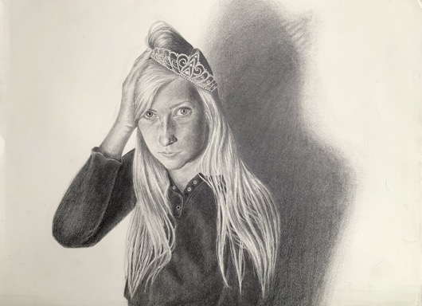
Scholarship Awards
Sophomore/Junior Scholarship Amount: $500
Rachel Kercher
Title: Hand Holding Spoon + Self Portrait (graphite + graphite)
Gift of: Linda Willis

Slide 33
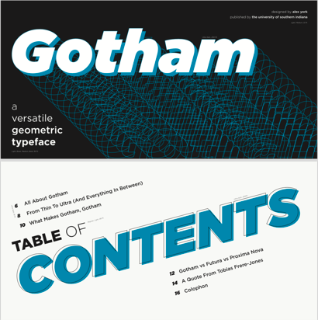
Scholarship Awards
Virginia Thomas Memorial Design Scholarship Amount: $500
Alex York
Title: Invasive Species + Type Specimen Book (digital + digital)
Gift of: Daniel C. Mason '95 & John Nordgauer

Slide 34
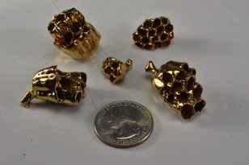
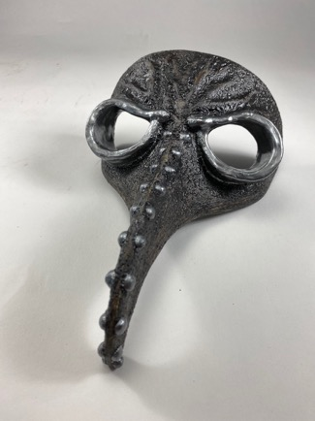
Scholarship Awards
Sophomore/Junior Ceramics Scholarship Amount: $500
Alyssa Smith
Title: Doctor Is In + Weight in Gold (stoneware + porcelain paperclay, wasp nest, gold luster)
Gift of: Andrea M. Hoelscher, Larry & Hazelann Hutchison, Shannon Pritchard, Roberta A. Schweizer, Scott S. '17 & Madeline R. '17 Sherwood

Slide 35
Class Awards

Slide 36
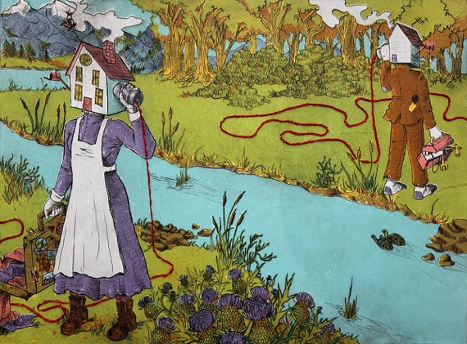
Class Awards
Postgraduate Merit Award Amount: $150
Hannah Jones
Title: Water Always Meets In Its Lives and So Do We (drypoint, screen print & embroidery)
Gift of: Joseph C. & Connie D. McConaughy, Brett R. & Erika C. Anderson

Slide 37
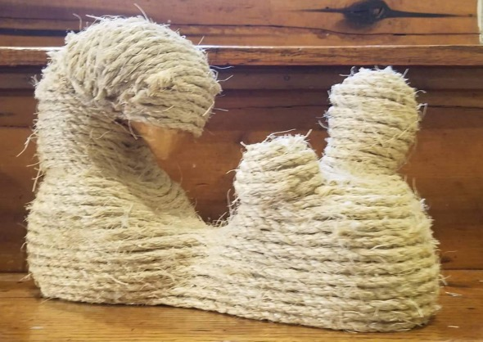
Class Awards
Freshman Merit Award Amount: $200
Violet Thomas-Cummings
Title: Daydreaming + The Inner Buzz + Snick (wood, wire, paint + graphite, charcoal, paint + plaster, twine, paint)
Gift of: Mary S. & David A. Bower, Alan N. & Susan Shovers

Slide 38
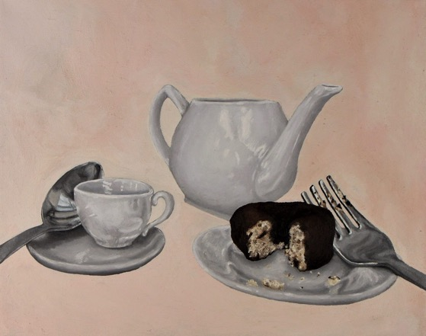
Class Awards
Sophomore Merit Award Amount: $200
Kaitlyn Statz
Title: Forest Music + Unproportioned Memories (oil on canvas + oil on canvas)
Gift of: Chuck & Julie '97 Armstrong, Matthew R. Graham & Kathryn M. Waters, David & Jane A. '89 Vickers

Slide 39
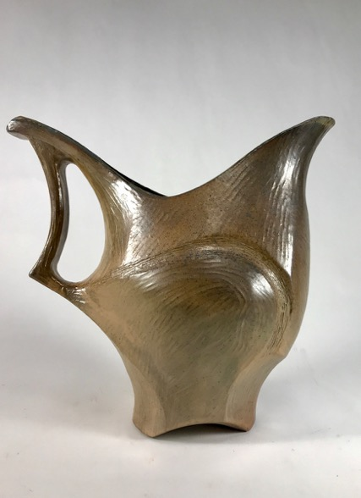
Class Awards
Junior Merit Award Amount: $200
Cole Collier
Title: Jarra de Tierra (stoneware, glaze)
Gift of: Kyle N. & Jessica McDaniel ’05 Bryant, Izzy Ferraro ’19

Slide 40
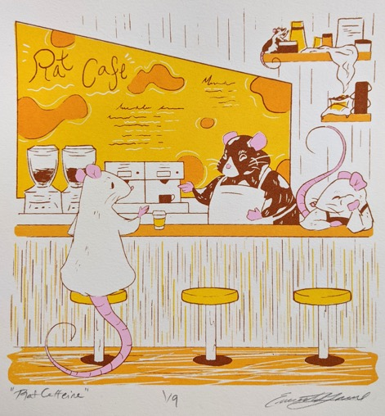
Class Awards
Senior Merit Award Amount: $200
Emerald Greene
Title: Rat Caffeine + Adventure Awaits (screen print)
Gift of: Alexander M. '13 & Kristina F. '13 Arwood

Slide 41
Show Awards

Slide 42
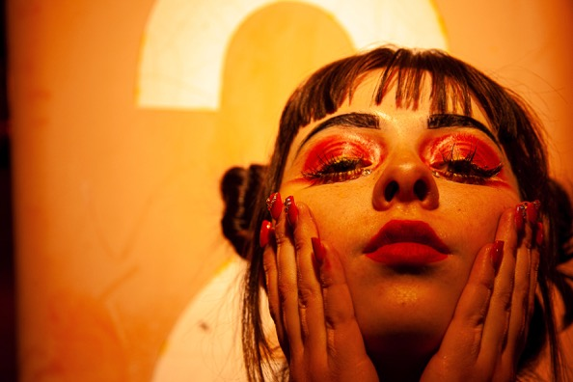
Show Awards
Third Place Overall Amount: $500
Courtney Gardner
Title: Warmth (digital)
Gift of: Jenna Rueger Citrus '15

Slide 43
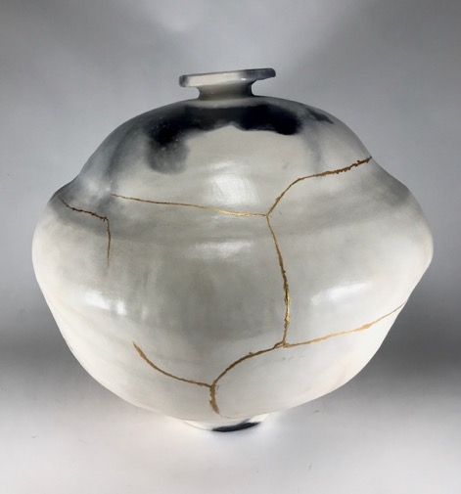
Show Awards
Second Place Overall Amount: $600
William Schmidt
Title: Amateur Hours (clay)
Gift of: Patty Beagle M'05, Edward F. & June Frederking, Chester A. Geiselman '84, John V. & Konnie Schlechte

Slide 44
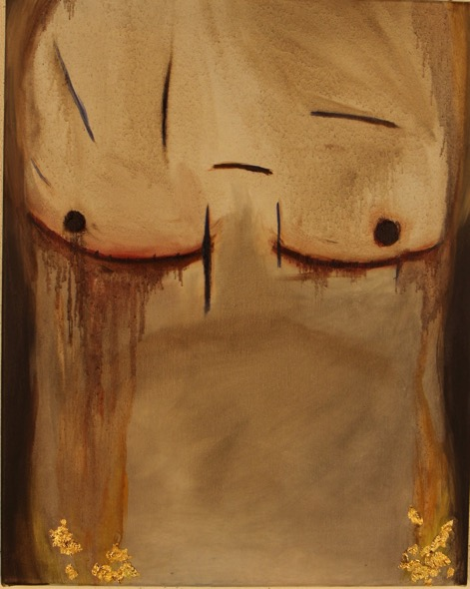
Show Awards
Best of Show Amount: $750
Candice Beck
Title: Rebirth (Liam) (oil and gold leaf on canvas)
Gift of: Tim Mahoney

Slide 45
The Art & Design Department
Congratulations to all of our artist participants.
Thank you for your time.
Awards Presentation

Slide 46
Show Awards
Purchase Award Amount: $100
Kassiti Fink
Title: Colorful Me (illustration)
Gift of: Corliss Chastain, Stephen W. Pfingston '75 & Linda Westfall, Daniel J. & Susan C. M'16 Sauls

