Slide 1
How to set up a tutoring appointment

Slide 2
1. Go to your “myusi” and log in

Slide 3
2. Click the “Tutortrack” icon
TUTORTRACK

Slide 4
3. click search Availability

Slide 5
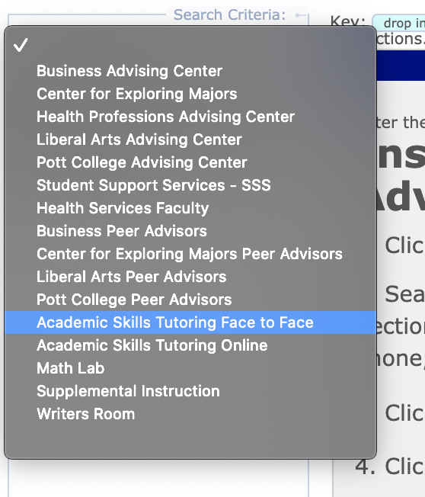
4. Click “Please Select a CENTER” AND CHOOSE A CENTER FOR TUTORING

Slide 6
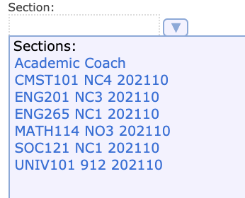
5. Click section and choose A class that you need help with and then click search
Allows you to choose a specific tutor (for example if your professor recommends someone)
Used to select a time that works best for you
Changes the time frame in which you want to have your tutoring

Slide 7
6. Choose from the many options by choosing a green time slot

Slide 8
7. Insert the information needed and click save
You should receive an email with information after you sign up for an appointment.

