Slide 1
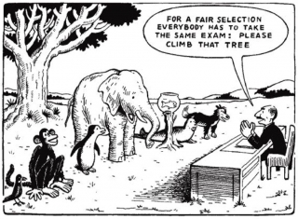
Accessibility and Usability
Online Instruction
USI Disability Resources
Notes:
When thinking about accessibility, try to think of universal design. Changes that we implement for students with disabilities help everyone.

Slide 2
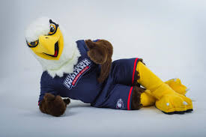
Why is this topic relevant to you?
Just like in a traditional on-campus classroom, we must ensure that all students have access to lectures and course materials offered in an online class environment.
Notes:
A lot more people with disabilities are pursuing post-secondary education. Technology is constantly changing/improving making this possible. When students with disabilities apply to any University, they do not disclose they have a disability. This happens after acceptance. There are some key things we can do to not only make our courses accessible to students with disabilities, but also more usable for students with various learning styles and preferences.

Slide 3
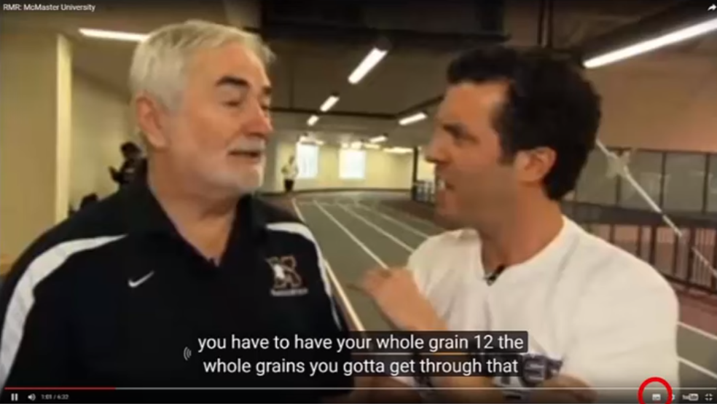

What makes web content accessible?
Notes:
YouTube automatic captioning is wonderful, but not always accurate. Turn the volume off to find out if it’s accessible or not. There have been many lawsuits in recent years because of colleges not offering closed captioning for online video content.

Slide 4
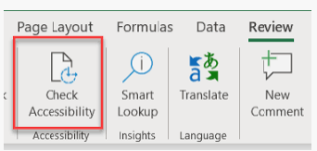
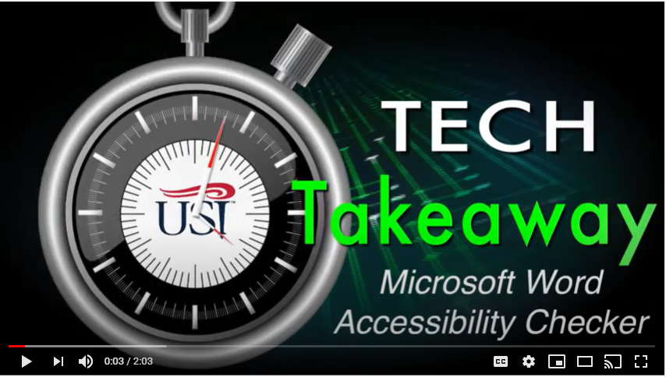
What makes web content accessible?

Slide 5
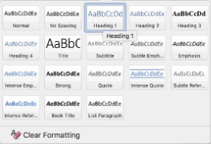

What makes web content accessible?
Texts
Word document are formatted using the styles for headings. For most students it is also beneficial to include a table of contents for long documents.
PDF documents are selectable
The texts on each PowerPoint presentation slide is concise as possible. Keeping presentations short and precise also keeps a viewer's attention for longer and avoids those with cognitive disabilities from getting distracted.

Slide 6

What makes web content accessible?
Fonts
Notes:
Fonts Choose a sans serif font such as Arial or Helvetica instead of Serif for your text. These fonts are easier to read for most people but especially for those with low vision.

Slide 7
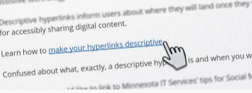
What makes web content accessible?
Hyperlinks
Text for links are concise but descriptive
Like this: Writing Good Link Descriptions
Not this: Click here for information on writing good link descriptions

Slide 8
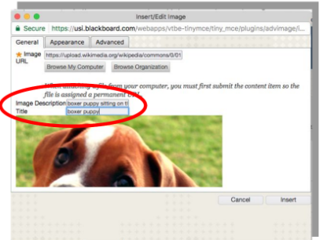
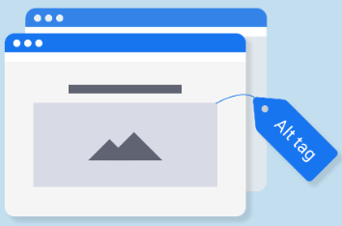
What makes web content accessible?
Images/Graphics
Every image and embedded media that conveys content has an equivalent alternative text (alt-tag )or long description
Decorative graphics have null/empty alt values (alt="")
Avoid the use of flashing images. Flashing images may cause seizures for students with photosensitive epilepsy, and may be distracting for students with learning disabilities

Slide 9


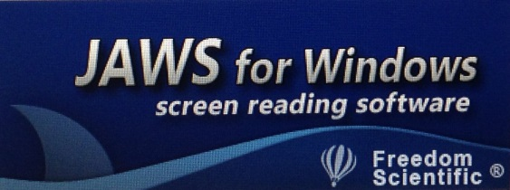
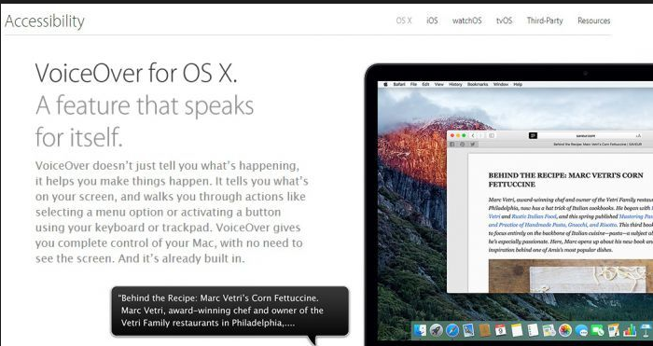

Assistive Technology
Notes:
These are some assistive technology, mainly screen readers, commonly used by students at USI.

Slide 10
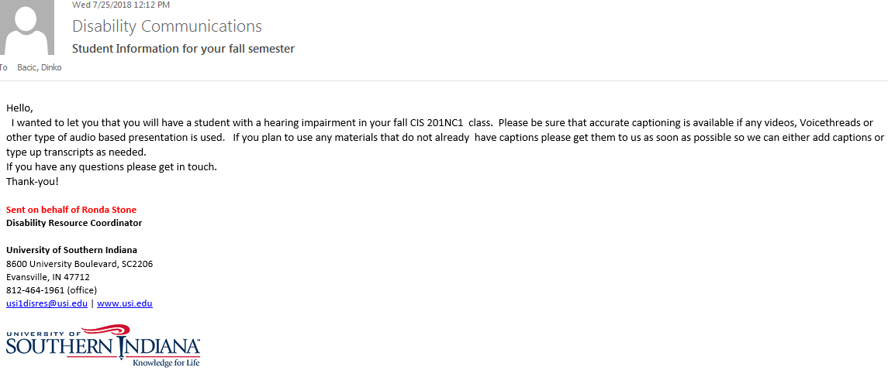
Striving for proactivity versus reactivity
Law Suit Video
Notes:
When students disclose a disability to DR, faculty are notified several weeks before the semester begins. DR staff is happy to help when you receive one of these emails and you would like some assistance with video captions, PowerPoint accessibility, etc…

Slide 11
Legal Obligations
}
ADAAA Amended 2008
Disability: Physical or mental impairment that substantially limits one or
more major life activity
Section 504 of the Rehabilitation Act 1973
No otherwise qualified handicapped individual in the United States shall,
solely by reason of his handicap, be excluded from the participation in, be denied the
benefits of, or be subjected to discrimination under any program or activity receiving
Federal financial assistance.
Section 508 of the Rehabilitation Act
Amended 1998
Federal Agencies with online web content must eliminate barriers in information
technology. Individuals with disabilities must be guaranteed comparable access to
information others have.
WCAG 2.0
Web Content Accessibility Guide
Access
Notes:
I don’t talk a whole lot about this. It’s good to mention and be aware of.

Slide 12
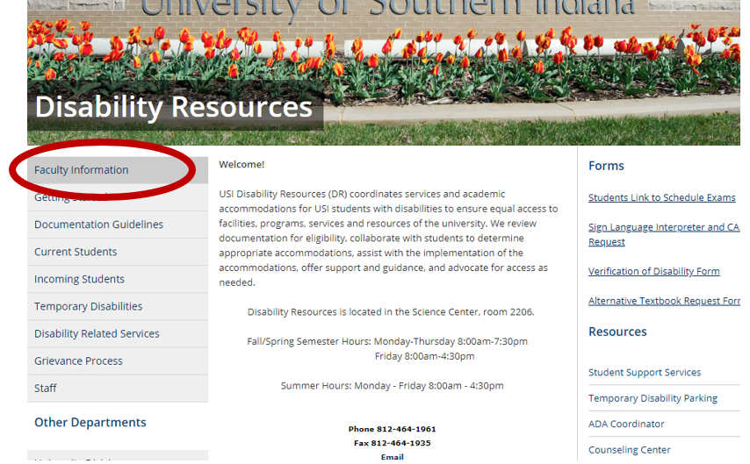
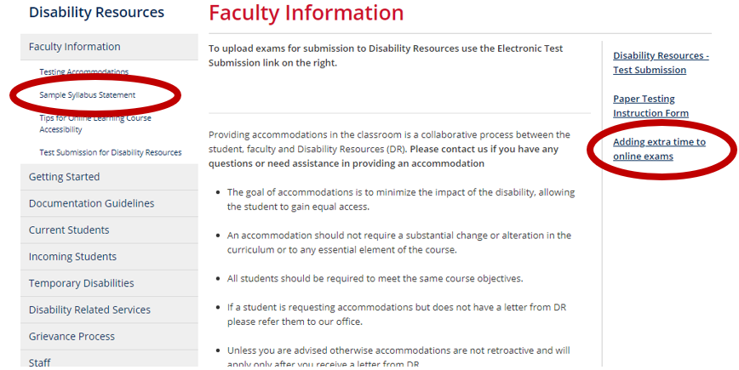
General Housekeeping
There are 2 syllabus statements:
Traditional courses
Online Learning courses
The syllabus statements are in the faculty information section of the Disability Resources webpage.
Extra Time Accommodations:
Look for video in email sent with student’s professor letter or in the faculty information section of the DR webpage.

Slide 13

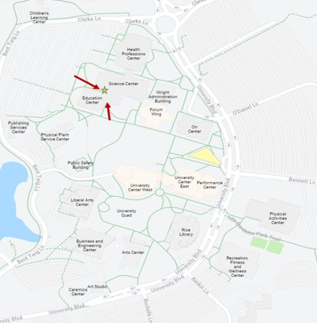


USI Disability Resources
Ronda Stone – Manager
rfstone@usi.edu
Katie Dausman – Coordinator
kedausman@usi.edu
Michele Barnett – Senior
Administrative Assistant
mrbarnett@usi.edu
Science Center 2206
812-464-1961

