Slide 1
IT Alliance Meeting Chair’s Report
December 9, 2015

Slide 2
Critical Factors considered in updating the IS Curriculum
IT-enabled Solutions Using Abilities, Knowledge, & Skills
Pressure for Change from Stakeholders
International Factors
AACSB, IS 2010 & 2015 Model Curriculum
Future Trends
Local University Particularity
21st Century Skills Identified
Liberal Art Factors

Slide 3
Major Curriculum Changes to be implemented in Fall 2016
As Jennifer indicated, CIS111 and CIS261 were collapsed into CIS201.
CIS305 was modified to include ERP and is now called CIS301.
Thanks to Dean Khayum’s leadership, these changes were made to the CIS discipline as well as to the RCOB Core.

Slide 4
Recent Faculty Development Activities
Dr. Srishti Srivastava attended the workshop named Education in HPC at the ACM Super Computing in November.
Dr. Abbey Foroughi presented a paper and attended a workshop at the Annual Meeting of the Decision Sciences Institute on how to introduce business analytics into the IS curriculum.
Dr. Dinko Bacic will attend the ICIS Business Analytics (BA) Congress, from Dec 12-13.
In early January, three faculty Drs. Foroughi, Gillard and Williams will attend ERP training at Sam Houston University, in Huntsville, Texas.

Slide 5
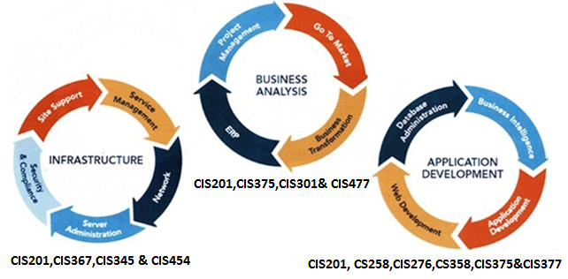
Career Opportunities for Graduates, based on Course Coverage of Knowledge and Skills in the Program Map

Slide 6
Big Data Analytics - a chance for getting closer to the Truth.
Traditional Data Sources
Small volume – low statistical power
Limited variety – Biased estimates
Low velocity – estimates may not be valid in the future
Untapped Sources
High volume – high statistical significance - small p value
High variety – small bias
High velocity – dynamic update of estimates

Slide 7
Enrollment Trends for CIS and CS Majors over the Past Five Years
Year | 2008 | 2009 | 2010 | 2011 | 2012 | 2013 | 2014 | 2015
#CIS students | 124 | 124 | 159 | 159 | 132 | 135 | 122 | 115
# CS students | 88 | 81 | 100 | 103 | 135 | 135 | 159 | 189
Total | 202 | 205 | 259 | 262 | 267 | 270 | 271 | 304

