Slide 1
Welcome to Pack Your Bags!
Presented by Shelly Copeland
Independent Travel Consultant
Haynie Travel Service

Slide 2
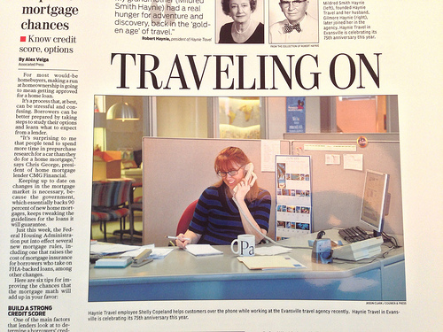
Featured in the Courier & Press story April 7, 2013
Haynie Travel Service is celebrating 75 years in service. Founded by our current owner’s, Bob Haynie, grandmother Mildred Haynie, at a time when women rarely worked let alone start businesses. It was one of the first travel agencies in Indiana.

Slide 3

A World of Experience
Our agents have on average over 20 years of experience each.
Our agency is known for the personalized travel planning experience that mature travelers are looking for.

Slide 4
Why should you use a Travel Agent?
You have the time and the means to plan your dream vacations
You can benefit from the expertise a travel agent brings on all of the different realms of the travel industry
You can trust that a Haynie Travel Services agent will be there for you 24/7 365 days a year. We want to get to know who you are and how we can best meet your travel needs

Slide 5
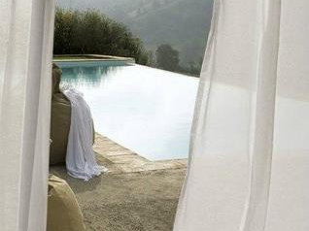
“People don’t take trips…trips take people.”
-John Steinbeck
Your vacation should take you away to anywhere you dream to go

Slide 6
Where are our Senior clients going?
From January 2012 – Current, we had 100+ clients who classified themselves as “Seniors” in our Marketing database
The top destinations are:
  Alaska
    Primarily land tour and cruise combinations
  Europe
    FIT – Foreign Independent Travel
      Or Escorted Group tours

Slide 7
  Cruises
    Mediterranean
    River Cruising
    Caribbean
  Hawaii
    Land only, multi island stays
    In conjunction with a cruise
  All Inclusive Resorts
    Caribbean
    Mexico

Slide 8
  Specialty Destinations
    African Safari
    South America
  Other USA destinations
    Disney World – with the grandkids!
    California
    Arizona
    New England

Slide 9
An interview with a current Senior Client
Current age is 77. He started checking off Bucket List destinations in his early 50’s.
Chose climbing Mt. Kilimanjaro as one of his first trips because he knew that would be physically demanding and he was still in good shape.
Although he has had a knee replaced he was still ziplining and climbing volcanoes in Costa Rica two years ago

Slide 10
Camped 9 days in the bottom of the Grand Canyon
Fished in the Amazon (about 12 times now)
Last year went on a Napa Valley and Sonoma wine tour (on his wife’s bucket list)
Current itinerary – Italy – where his grandparents migrated from as young adults
Still to do – New Zealand!

Slide 11
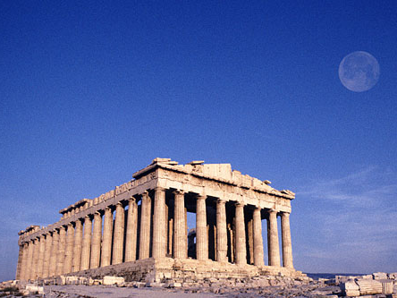
What destinations are on your Bucket List?
Let’s compare your thoughts to the Top 10 list compiled by Forbes that goes a little outside the box of the usual bucket list destinations.

Slide 12
Top 10 Once in a Lifetime Trips
Safari South Africa
Bhutan
USA Cross Country
Easter Island
Bali, Indonesia
Heli-skiing
Iguacu Falls
Oktoberfest
Scotland
Space

Slide 13
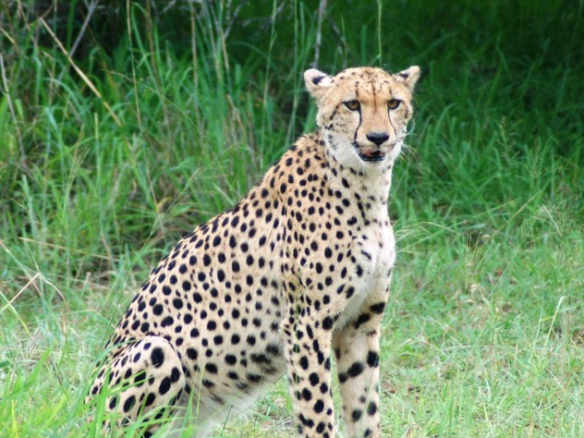
#1 – Safari South Africa
Not your run of the mill African Safari. Compared to other safari destinations, South Africa (featuring Cape Town) has an amazing amount of diversity in an easily navigated country, along with five star lodging, wine and cuisine.

Slide 14
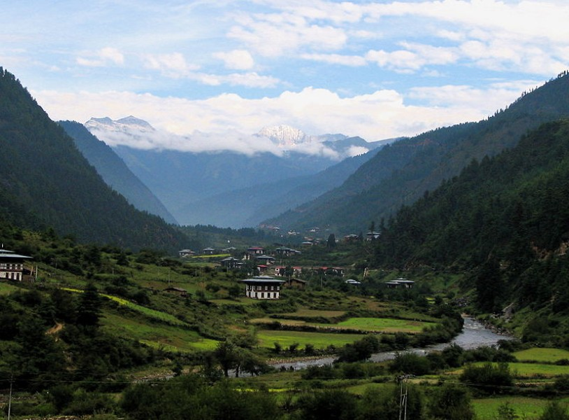
#2 Bhutan
The only Buddhist nation on earth is also the only one that measures its success in terms of "Gross National Happiness."

Slide 15
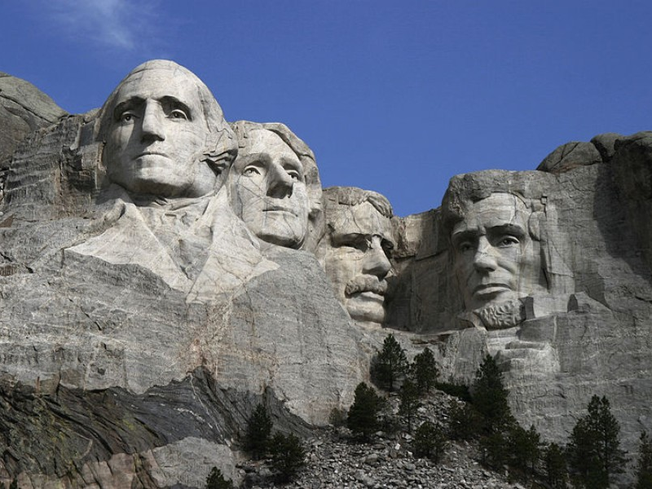
#3 Cross Country USA
The coast to coast traverse of the United States is steeped in lore and an iconic part of the nation's auto-centric heritage, going back to the days of Route 66, but how many people actually experience this great trip?

Slide 16
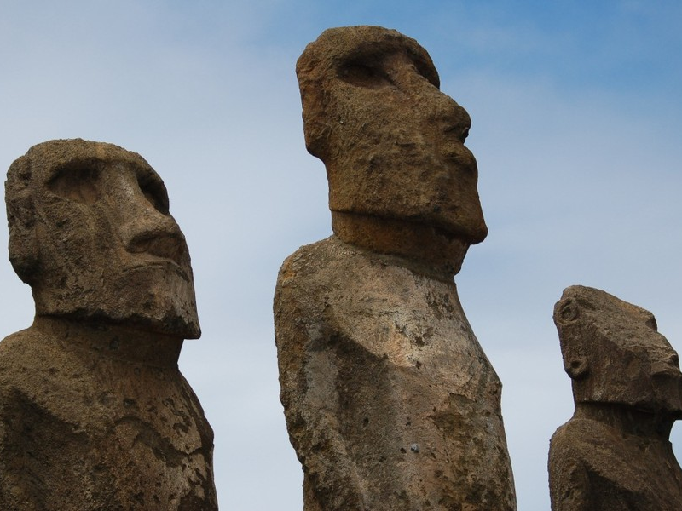
#4 Easter Island, Chile
One of the most unique and interesting places on earth, the ghostly carved rock statues of Easter Island, the Moai, are unlike other ruins of older civilizations because so little is known about the people who built them, why they were built, or how they were moved.

Slide 17

# 5 Bali, Indonesia
There is a reason why Bali has become synonymous with tropical fantasy: it is beautiful, exotic and very varied yet manageable.

Slide 18
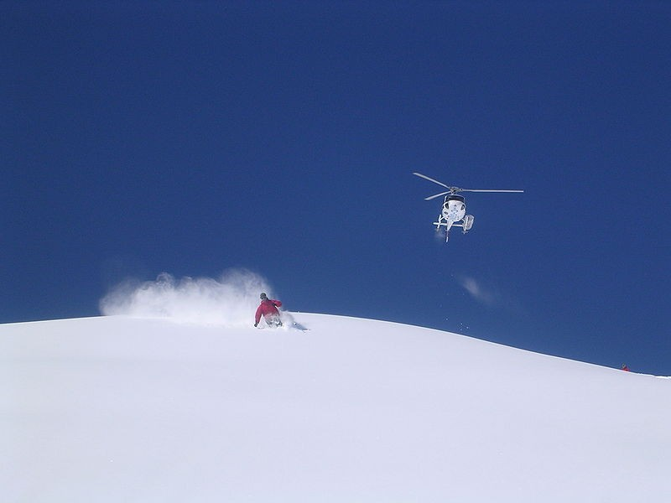
#6 Heli-skiing
If you love skiing or snowboarding you have to try it - heli-skiing is the sport's Holy Grail. The adrenaline rush of soaring high into remote peaks and taking in epic vistas from the helicopter is merely an added bonus.

Slide 19
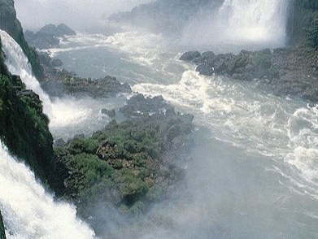
#7 Iguacu Falls
"Poor Niagara!" is what First Lady Eleanor Roosevelt is said to have exclaimed upon glimpsing this stunning set of cataracts on the border of Brazil and Argentina.

Slide 20
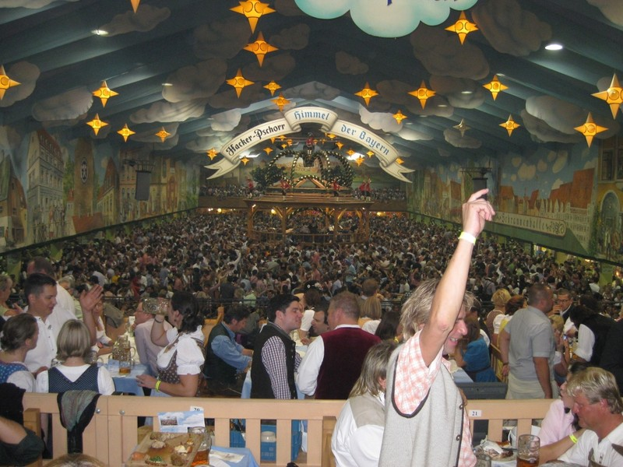
#8 Oktoberfest
203 years young, it's simply the biggest party in the world, and with good reason. The 16-day festival, which despite its name is mostly in September, routinely attracts over 6 million visitors.

Slide 21
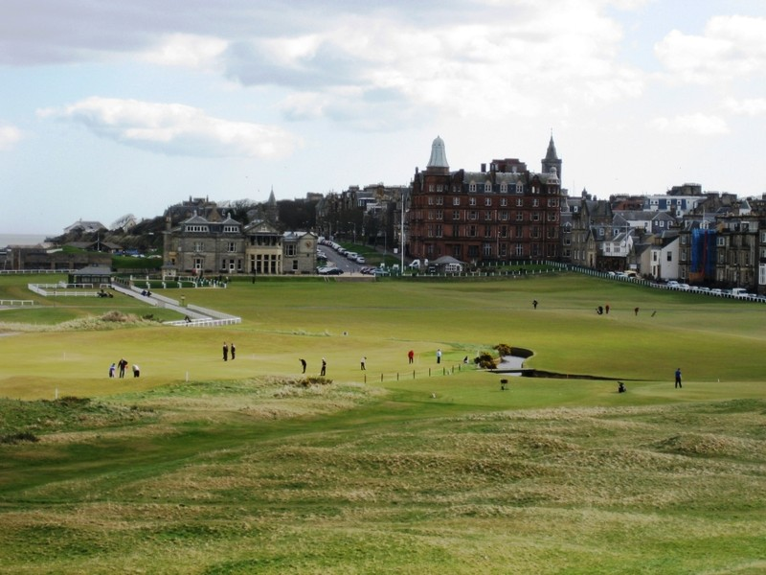
#9 Scotland
If you are an avid golfer, there are fantastic courses in every corner of the globe, but the trip of a lifetime begins where the game was born, on the Old Course at St. Andrews.

Slide 22

#10 Space
The projected debut of scheduled commercial space travel is “late 2013,” so you will probably have to wait beyond this year to get your spot on Virgin Galactic, since the first 500 seats were already sold.

Slide 23
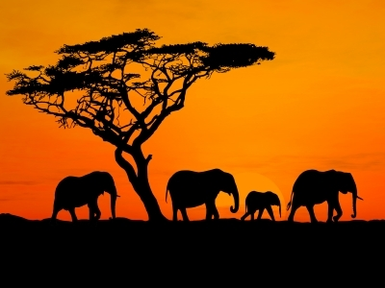
Haynie Travel African Safari 2013
Visit our website at www.haynietravel.com to view the full video. It is beautiful and most photography was taken by one of the members of the group!

Slide 24
5 Frugal travel tips
Proclaim your age! Be sure to claim any senior discounts that might be offered
Look beyond the travel websites. Enlist the help of a travel agent who has access to package pricing and last minute discounts
Comparison shop – low season/high season
Travel with a group
Swap your house

Slide 25
Budgeting for Travel in your Retirement Years
Start now – whether you are just entering your 50’s or already in your 70’s – give travel a piece of your monthly budget
Set goals – both monetary and to prioritize those bucket list destinations
Begin with choosing one or two major trips a year of one to two weeks in duration
Then select a few smaller trips closer to home for long weekend getaways

Slide 26
Sit down with your travel agent to discuss the approximate costs of your choices
Treat your travel expenses as part of your regular household budget, such as food, housing, and medical.
Use the “whatever is left over” goes to travel method or if saving for a particular trip set aside that amount monthly until you have reached that goal

Slide 27
These methods can be utilized by those on fixed incomes as well as those with large investment portfolios to draw from
It may take a bit longer if you are on a strict budget, but you can still cross off those bucket list destinations
If your budget needs a few extra dollars, consider a part time job you love (so it’s not so much like work)

Slide 28
Remember to budget your Age as well as your money
Some destinations will be much more suited to exploring in your earlier years of retirement and saving the more relaxing destinations for later years

Slide 29
Final Thoughts
Remember to visit the Haynie Travel website at www.haynietravel.com for a wealth of information and for our current promotions!
Join us on Facebook. Like the Haynie Travel Facebook page and join our other Friends as we share travel photos and more!
Come by our office at 641 S Hebron any day. All of our agents are there to help you further investigate any of the great bucket list destinations you saw today and a world of other ideas!

Slide 30
Questions?

